Slide 1
Engaging Students in Construction Safety Research
Lu Yuan, Sc.D., CSP
Occupational Safety, Health, and Environment

Slide 2
OSHE 382 Construction Safety
One of the core courses in the OSH&E curriculum
Addresses the application of management principles, communication and human relations factors, safety/health rules, industry and federal standards, accident investigation, and technical issues especially within the job planning phases in the construction industry.

Slide 3
OSHE 382 Final Project
The OSHE 382 final project serves as the experiential-learning component for Construction Safety.
Students are first “randomly” assigned in groups to each construction company.
The contact person of each company assigns a specific topic to each group.
The company provides necessary information to the students through field trips to the company’s construction site as well as opportunities of visiting the company’s office, interviewing the company’s employees, attending the company’s safety and/or project meetings, etc.

Slide 4
OSHE 382 Final Project
The students then conduct the quantitative and qualitative analyses on the assigned topics/issues, and present the study in the third unit of the class when the company’s representatives are invited.
The contact person may present his view of the issue and his evaluation of the student groups’ work.
The student groups are required to submit a written report, following the guidelines for final project. The reports are to be sent to the companies so they may keep a record.

Slide 5
Objectives
The present case study is aimed to examine the effectiveness of the RWR initiative as a way to improve the process of engaging students in conducting construction safety research.

Slide 6
Methods
Students’ performance in OSHE 382 during the Spring 2016 semester was analyzed for the present case study.
A rubric was used for grading of the final project.

Slide 7
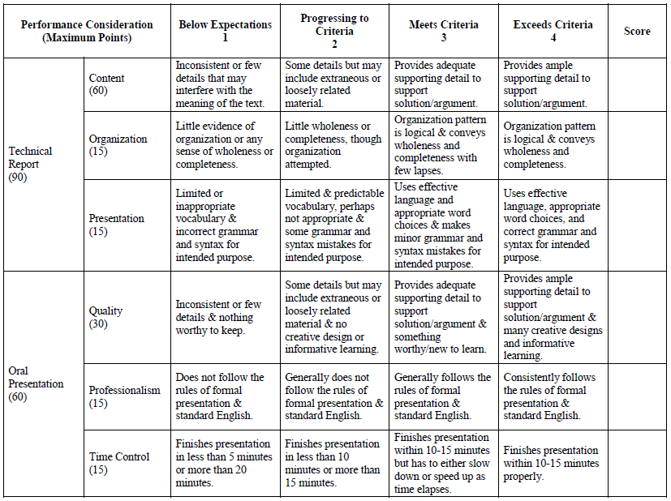

Slide 8
Methods
Thirty-two students enrolled in the class.
They were randomly assigned to a total of eight 4-person groups.
Seven of the eight groups were able to connect with construction companies.
One group was not able to find a construction company; but, it eventually connected with a manufacturing company that contains a fair amount of fall hazards which are the leading cause in the construction industry. Their project on analyzing fall hazards and recommending control measures was thus considered meeting the requirements.

Slide 9
Methods
A survey was handed out at the end of the semester, collecting information about students’ evaluation of their group members for the final projects.
It was also used a tool to assess the effectiveness of RWR component as well as the functionality of group project.
Its purpose was to identify the shortcomings of RWR component and team members, and to improve the experience with RWR component and group work.

Slide 10
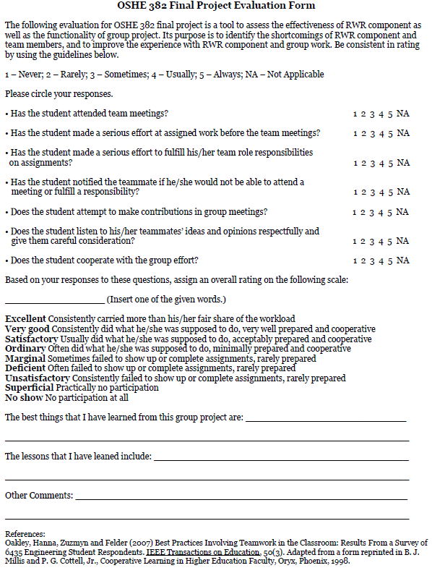

Slide 11
Results
Seven of the eight groups met or exceeded the expectations based on the rubric for final project evaluation.
Exemplary projects include: safety incentive program for Company A, drug testing for Company B, etc.

Slide 12
Results
The contact person from one of the companies attended the final project presentation and provided constructive feedback to the students.
The feedback that focuses on the delivery of presentation includes:
Familiarization with brief
Know the target audience and deliver to their level
Use of notes not common, information being read from the slides
Practice and be prepared to answer questions
Use more statistics and dollar amounts to show emphasis and support, i.e., OSHA fines, Insurance costs, FMLA costs, Equipment Delays, Retraining, etc.

Slide 13
Results - Survey
Questions | 1 | 2 | 3 | 4 | 5 | NA
Has the student attended team meetings? | 0.0% | 0.0% | 10.0% | 20.0% | 30.0% | 0.0%
Has the student made a serious effort at assigned work before the team meetings? | 0.0% | 3.3% | 10.0% | 26.7% | 60.0% | 0.0%
Has the student made a serious effort to fulfill his/her team role responsibilities on assignments? | 0.0% | 0.0% | 3.3% | 33.3% | 63.3% | 0.0%
Has the student notified the teammate if he/she would not be able to attend a meeting or fulfill a responsibility? | 0.0% | 0.0% | 6.7% | 13.3% | 76.7% | 3.3%
Does the student attempt to make contributions in group meetings? | 0.0% | 0.0% | 3.3% | 26.7% | 70.0% | 0.0%
Does the student listen to his/her teammates’ ideas and opinions respectfully and give them careful consideration? | 0.0% | 0.0% | 0.0% | 26.7% | 73.3% | 0.0%
Does the student cooperate with the group effort? | 0.0% | 0.0% | 0.0% | 13.3% | 86.7% | 0.0%
Note: 1 – Never; 2 – Rarely; 3 – Sometimes; 4 – Usually; 5 – Always; NA – Not Applicable

Slide 14
Results - Survey
In terms of the overall rating of the final project, 20% of the students rated “Excellent,” 36.7% selected “Very Good,” 33.3% chose “Satisfactory,” and the “Ordinary” rating accounted for 10.0%.
Typical answers to the question, “The best things that I have learned from this group project,” include:
How to efficiently work with other people on a given task
How construction companies actually handle safety
The role specific JSAs save employers on time
Leadership roles, organization
Answers to the question, “The lessons that I have leaned,” include:
Communication is very important.
The importance of self-identifying hazards in your workplace
Time management
How to work with the differences of others

Slide 15
Discussion
Overall, the majority of students seemed to gain a positive experience of conducting construction safety research through the RWR initiative.
Although Spring 2016 was the first semester that the RWR component was added into the class, assessment of the experiential learning has been conducted since Spring 2008 when I started teaching the class.
It would be interesting to compare the differences of students’ feedback in different semesters, so that the pros and cons of the RWR initiative could be better documented in order to improve student’s knowledge and skills about construction safety.

Slide 16
Questions and Comments? Thank you!

