Slide 1

Using E-Portfolios for Student Self-Reflection
& Archiving EL Experiences
Jack B. Bedell

Slide 2
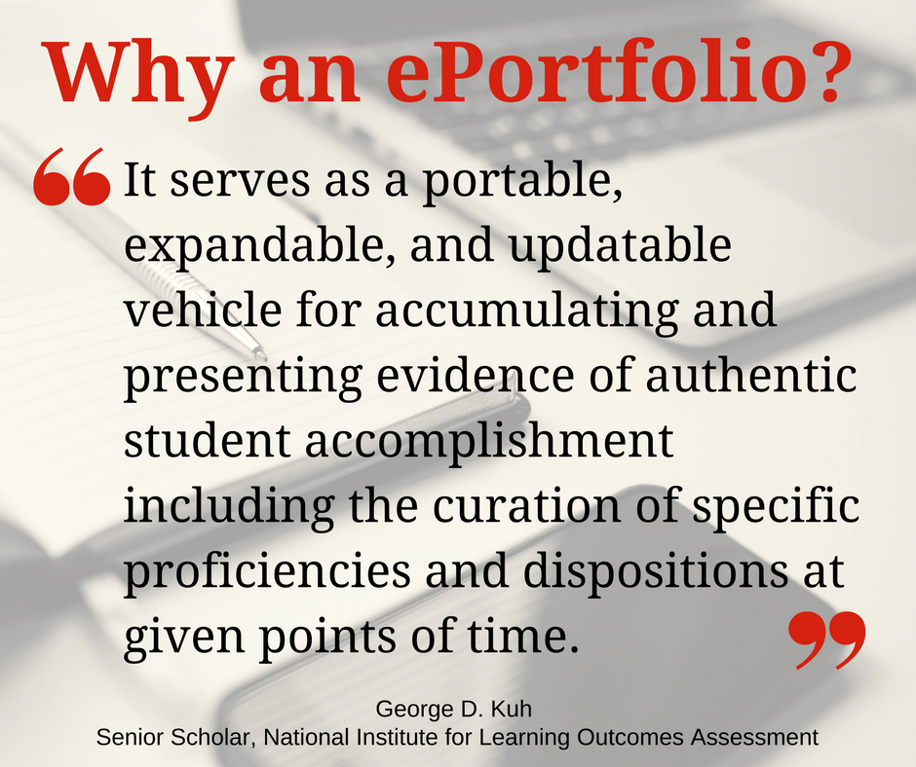
Form
& Function
E-Portfolios
and
EL Experience

Slide 3
Choosing a Platform
Baseline Requirements
Needs to be Web-based
Must be available via URL to both campus and non-campus users
Must have Landing or Home Page for Guidance of Visitors
Must Have Areas for Student Reflection on Content

Slide 4

Platform Options
Blogger (Google)
Wix
Weebly
Squarespace
Wordpress

Slide 5
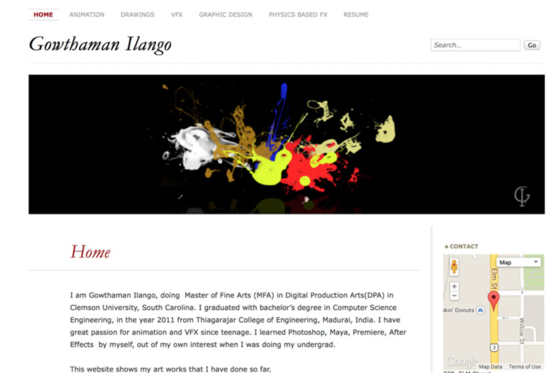
Archive-Based
Creative Dossier

Slide 6
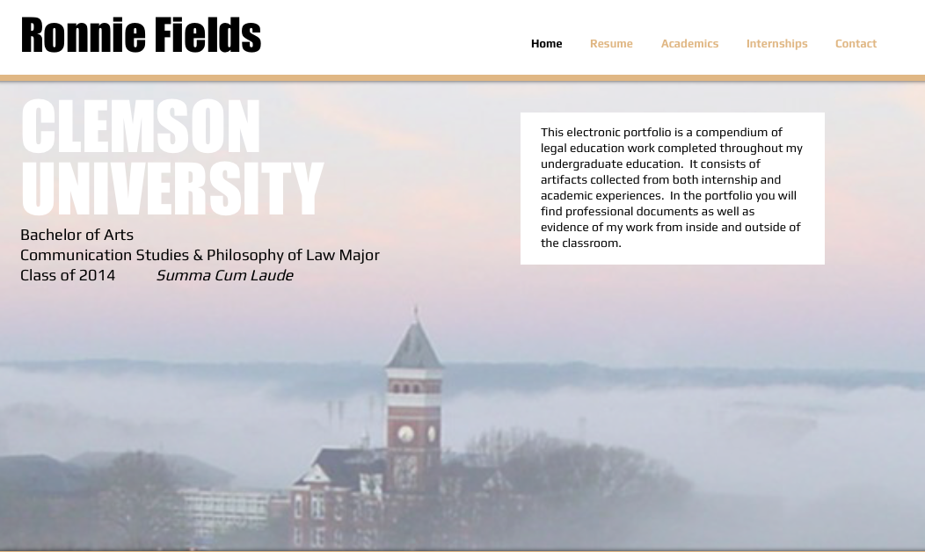
Experience-Focused
Reflection Log

Slide 7
Benefits as E.L. Learning Module
Measures growth over time (exp. to exp.)
Immediate reflection during and post experience
Base for development of professional portfolio
Speaks to learning process
Can be formative or summative
Students gain self-awareness, agency, and self-efficacy
Aligns easily with course objectives

Slide 8
Benefits to Professional Development
Demonstrates specific competencies
Flexible and portable as dossier
Visibility to potential employers
Builds confidence in own abilities
Demonstrates fulfillment of academic responsibilities

Slide 9
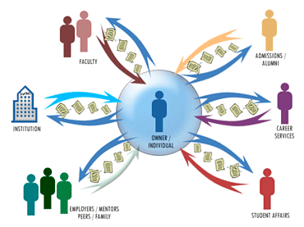
Workplace Viability
Currently, 3% of universities require e-portfolios
80% of employers express a desire for e-portfolios
45% of same employers find academic transcripts useful

