Slide 1

Getting Your Real-World Ready Course Ready to Go Into the World
Dr. Phillip D. Voegel
Department of Chemistry & Physics
Southeastern Louisiana University

Slide 2
Introduction
Active Learning:
  …anything course-related that all students in a class session are called upon to do other than simply watching, listening and taking notes.¹
Experiential Learning:
  …any learning that supports students in applying their knowledge and conceptual understanding to real-world problems or authentic situations where the instructor directs and facilitates learning.²
Service Learning:
  …credit-bearing experience in which students participate in an organized service activity that meets identified community needs and reflect upon the service activity in such a way as to gain fundamental understanding of course content, a broader appreciation of the discipline, and an enhanced sense of civic responsibility.³

Slide 3
Introduction
Identifiable Need
  2011 Yellow Water River Watershed does not meet criteria for primary contact recreation (PCR) and secondary contact recreation (SCR).⁴
    High levels of nutrients and fecal coliform bacteria
    Low levels of dissolved oxygen
    Highly urbanized land use.
  2012 Yellow Water River Watershed meets SCR criteria
    Lower levels of fecal coliform observed
  2014 Continued monitoring of Yellow Water River Watershed recommended.

Slide 4
Introduction
Identifiable Need
  Sanderson Farms Chicken Processing Plant
    Settling ponds for waste located adjacent to Yellow Water Creek
    High levels of phosphate common in chicken waste products
  Fecal coliform, nutrients, dissolved oxygen pH

Slide 5
CLAB 453 – Real-World Ready
Instrumental Analysis Laboratory
Upper level chemistry majors
Typical enrollment 10 – 12 students
Two weekly meetings
  Day 1 – Real-World Ready Project
  Day 2 – Traditional Laboratory Methods

Slide 6
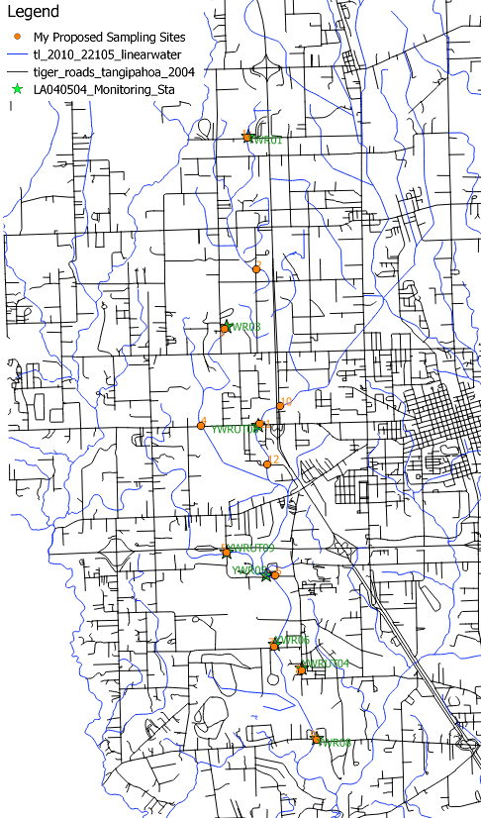
CLAB 453 – Real-World Ready
RWR Component
  Semester long project
  Setup field sampling sites
  Collect samples every two weeks
  Complete field measurements
  Provide samples to collaborators in biology
  Analyze samples for nutrients
  Write journal style final report

Slide 7
CLAB 453 – Real-World Ready
Initial Meetings
  Project Explanation & Background
  Environmental Site Selection, Preparation Methods
  Sample Collection Protocols
  Chemical Analysis Methods
  Complete necessary paperwork

Slide 8
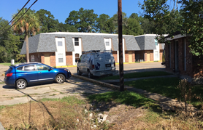
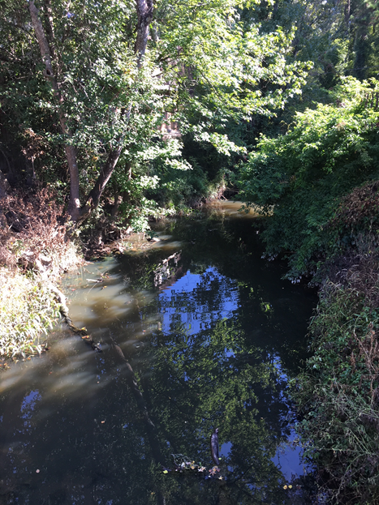
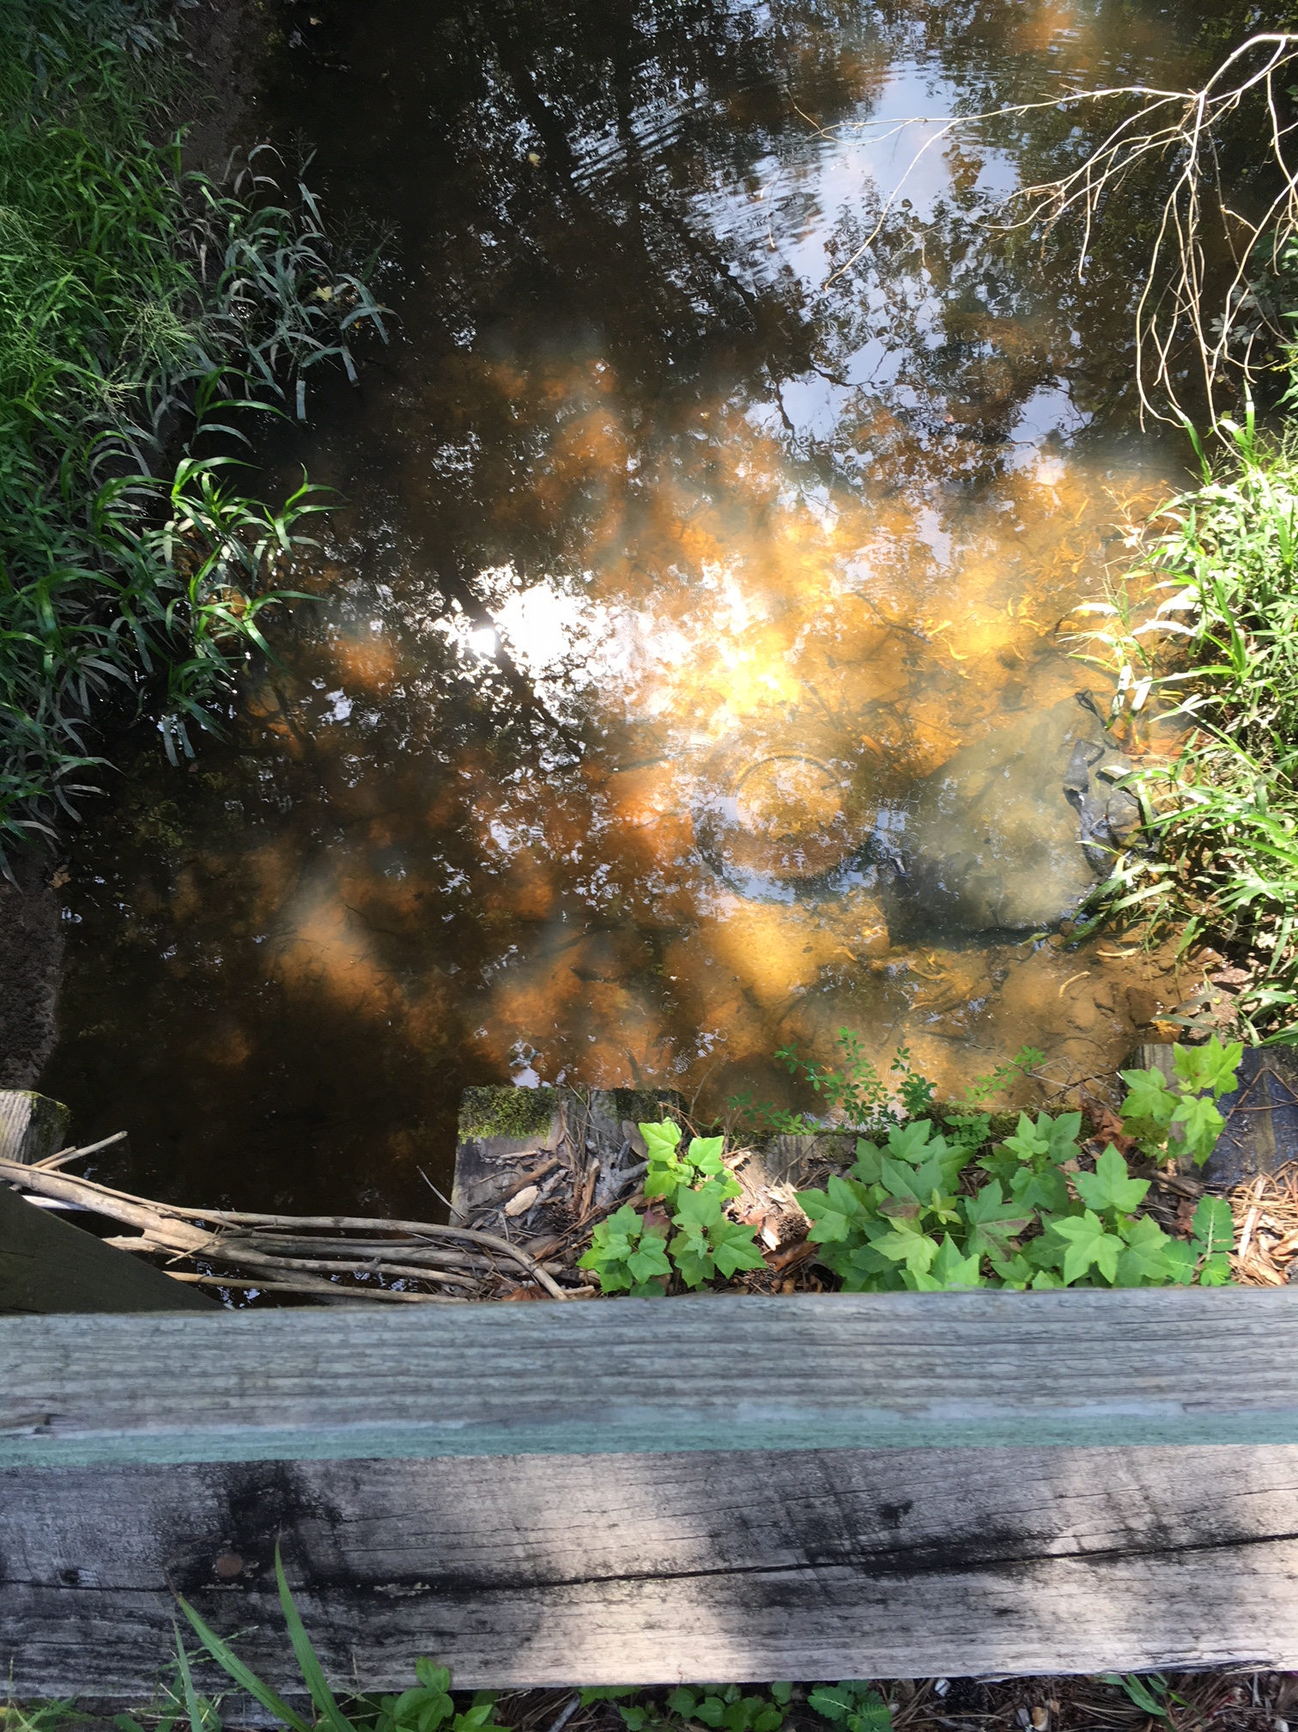
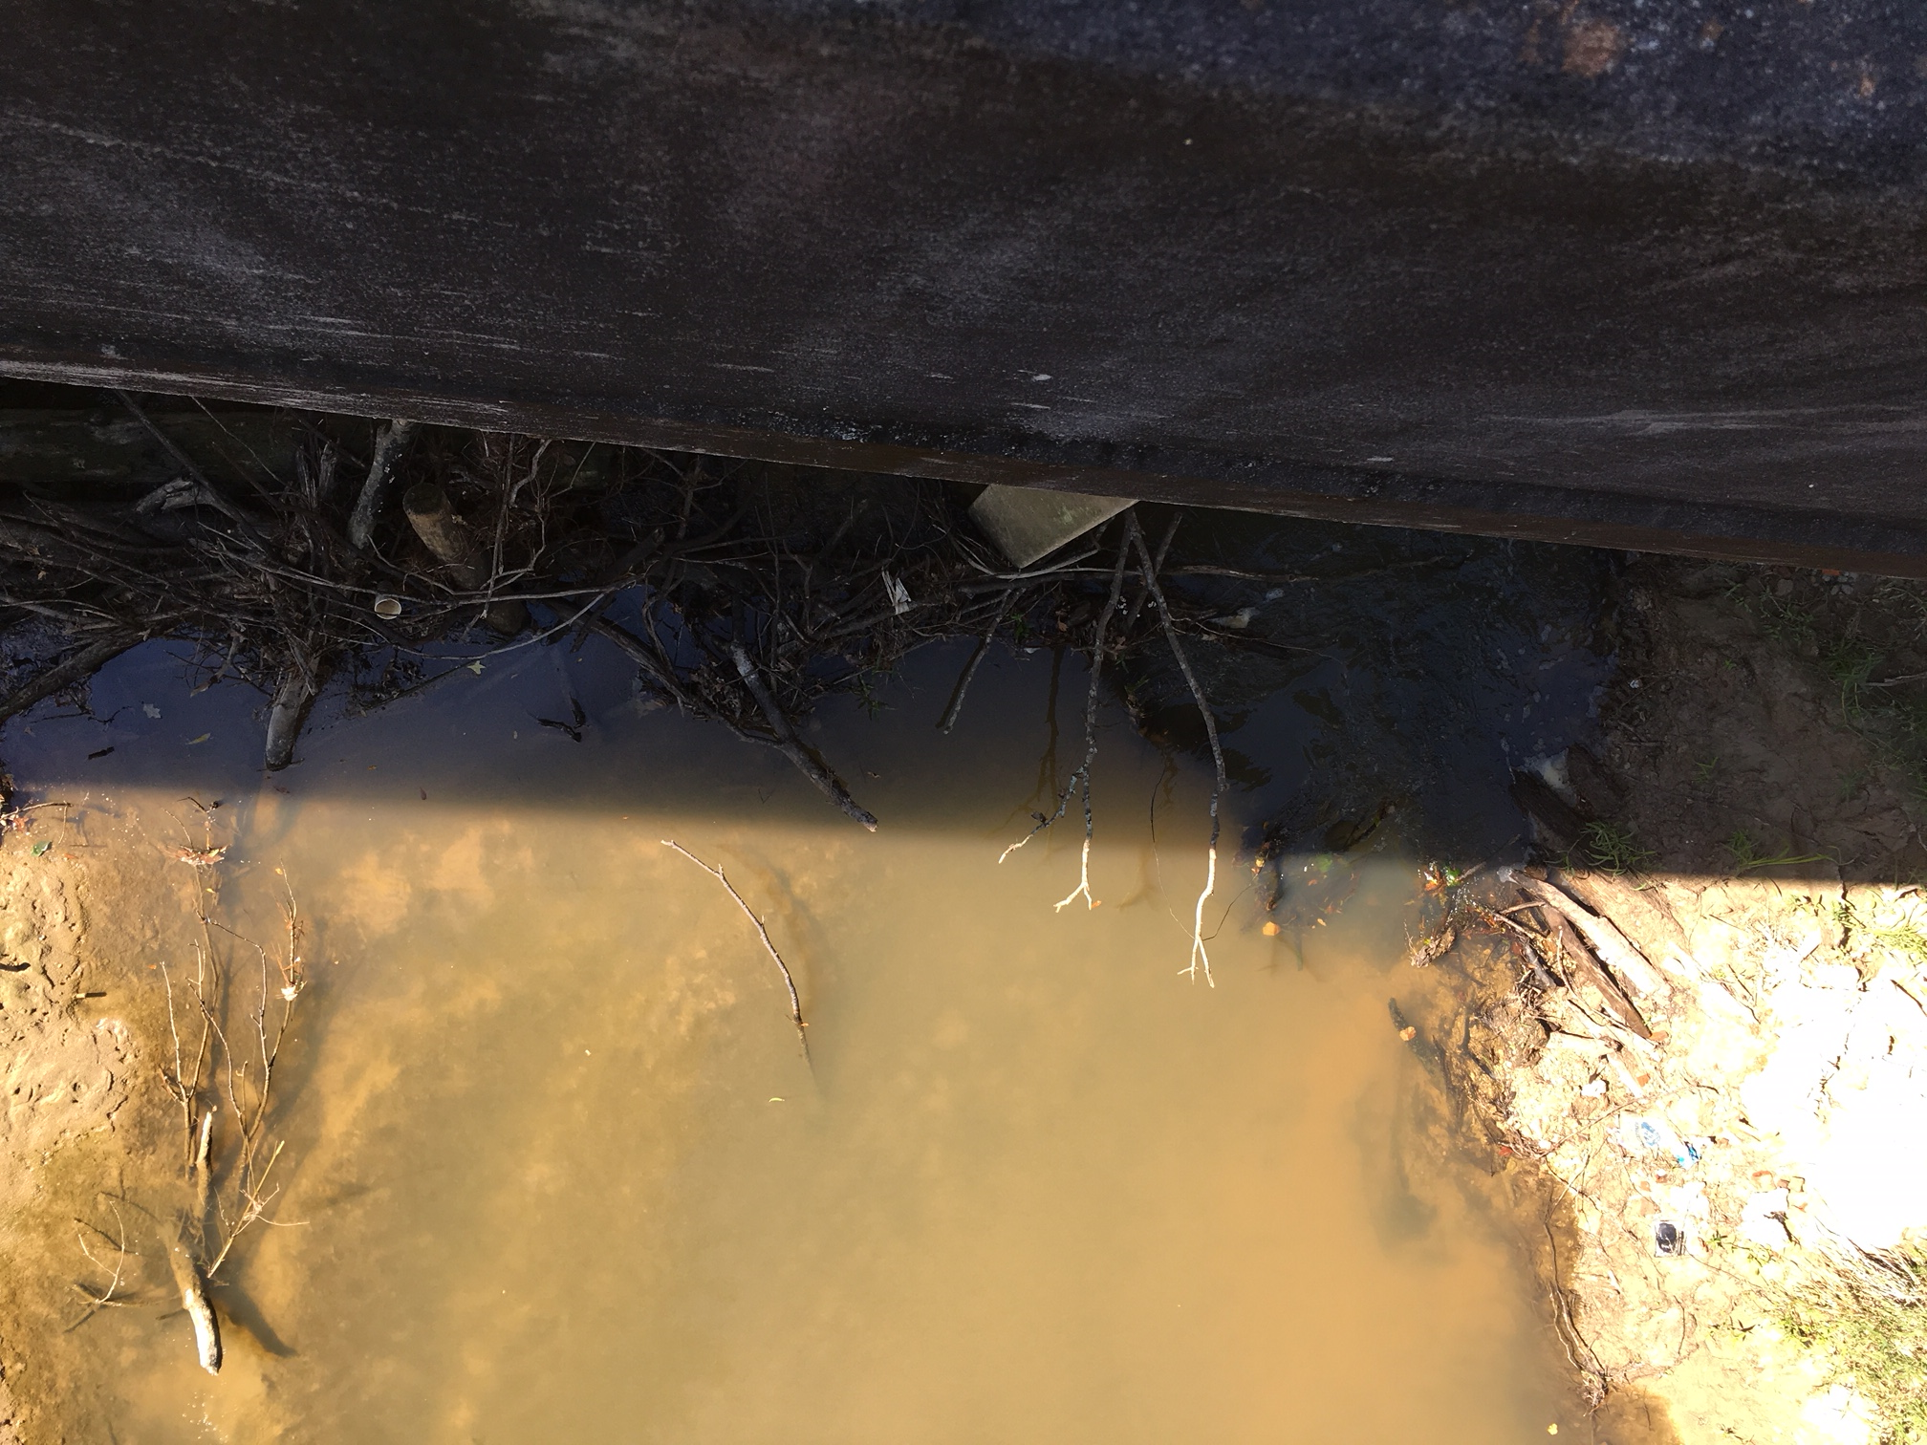
CLAB 453 – Real-World Ready
First Field Trip
  Meet at the Quick Blvd. site with field analysts from Louisiana Department of Environmental Quality
  Site Mark-up
    General site assessment
    Measure stream width
    Select lateral position
    Mark sampling location
  Complete field measurements
      Water depth, temperature, pH, dissolved oxygen
  Chemical Analyses
    Phosphate & Nitrate

Slide 9
CLAB 453 – Real-World Ready
Necessary Paperwork
  Affiliation Agreement:
    Sample Agreements found in RWR Faculty Resources Page
    Southeastern > Academics > Academic Programs > Experiential Learning > Faculty Resources

Slide 10
CLAB 453 – Real-World Ready
Necessary Paperwork
  Affiliation Agreement:

Slide 11
CLAB 453 – Real-World Ready
Necessary Paperwork
  Affiliation Agreement:

Slide 12
CLAB 453 – Real-World Ready
Necessary Paperwork
  Affiliation Agreement:
    Hold Harmless Section is very important

Slide 13
CLAB 453 – Real-World Ready
Necessary Paperwork
  Affiliation Agreement:
    Signatures – Should be completed before the project starts

Slide 14
CLAB 453 – Real-World Ready
Necessary Paperwork
  RWR Student Agreement:
    Examples on RWR website

Slide 15
CLAB 453 – Real-World Ready
Necessary Paperwork
  RWR Student Agreement:
    Examples on RWR website

Slide 16
CLAB 453 – Real-World Ready
Necessary Paperwork
  RWR Student Agreement:
    Examples on RWR website

Slide 17
CLAB 453 – Real-World Ready
Necessary Paperwork
  Faculty Check List:

Slide 18
CLAB 453 – Real-World Ready
Necessary Paperwork
  Faculty Check List:

Slide 19
CLAB 453 – Real-World Ready
Necessary Paperwork
  Faculty Check List:
http://www.southeastern.edu/admin/stu_orgs/student_res/offcampus2016.pdf

Slide 20
CLAB 453 – Real-World Ready
Necessary Paperwork
  Student Information for Off-Campus Trip Form:

Slide 21
CLAB 453 – Real-World Ready
Necessary Paperwork
  Student Information for Off-Campus Trip Form:

Slide 22
CLAB 453 – Real-World Ready
Necessary Paperwork
  Student Information for Off-Campus Trip Form:

Slide 23
CLAB 453 – Real-World Ready
Necessary Paperwork
  Off Campus Behavior Agreement

Slide 24
CLAB 453 – Real-World Ready
Necessary Paperwork
  Off-Campus Visitation Form:

Slide 25
CLAB 453 – Real-World Ready
Necessary Paperwork
  Off-Campus Visitation Form:

Slide 26
CLAB 453 – Real-World Ready
Necessary Paperwork
  Off-Campus Visitation Form:
v

Slide 27
References & Funding
Felder, R.M.; Brent, R. College Teaching 1996, 44(2), 43-47.
Wurdinger, S.D.; Carlson, J.A. Teaching for Experiential Learning: Five Approaches that Work; Rowman & Littlefield Education: Lanham, MD, 2009.
Bringle, R. G.; Hatcher, J. A. New Directions for Higher Education, 2009, 147, 37-46.
Louisiana Department of Environmental Quality, Louisiana Nonpoint Source Annual Report Federal Fiscal Year (FYY) 2011.
This project is partially funded by a Real-World Ready grant from the Southeastern Louisiana University Office of Experiential Learning (2017) and a Service Learning grant (2012) from Southeastern Louisiana University

