Slide 1
Helping Students Tell Their Stories: Reflection and Beyond
Brian Williams
Elizabeth Sanders

Slide 2
Importance of Reflection
Addresses Student Learning Outcomes (SLOs)
SLO 1: analyze and explain course application
SLO 2: demonstrate effective communication in a professional forum
SLO 3: reflect on RWR work, identify strengths/weaknesses, and affirm how experience help or not help planned endeavors

Slide 3
Importance of Reflection (cont..)
Self-Evaluation
Is this my future career?
Am I applying major courses?
Is this improving my personal and professional skills?
Am I making a difference on others?

Slide 4
Forms of Reflection
Periodic reports/journals
End of semester reflection paper
PPT or poster presentation
Weekly or bi-monthly group meeting
Weekly discussion board post
*USE MULTIPLE FORMS.. REFLECT, REFLECT!!

Slide 5
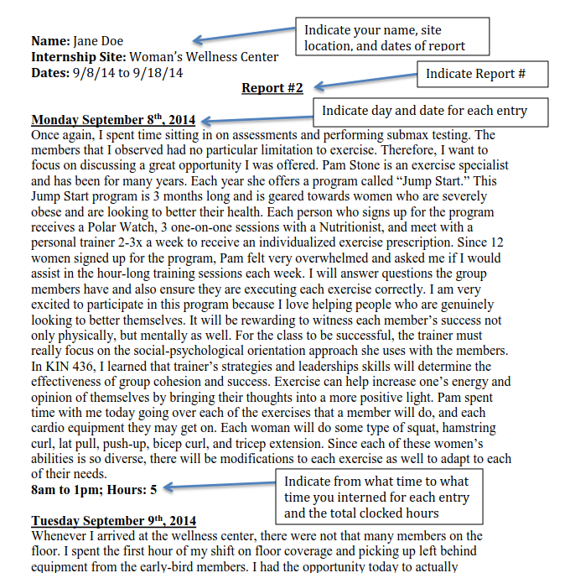
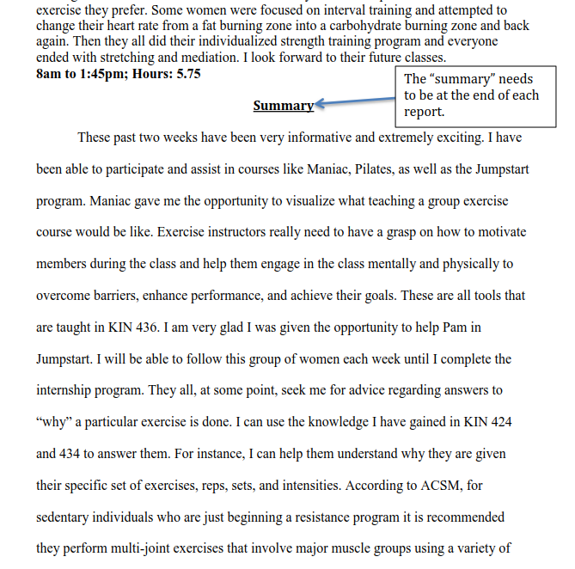

Slide 7
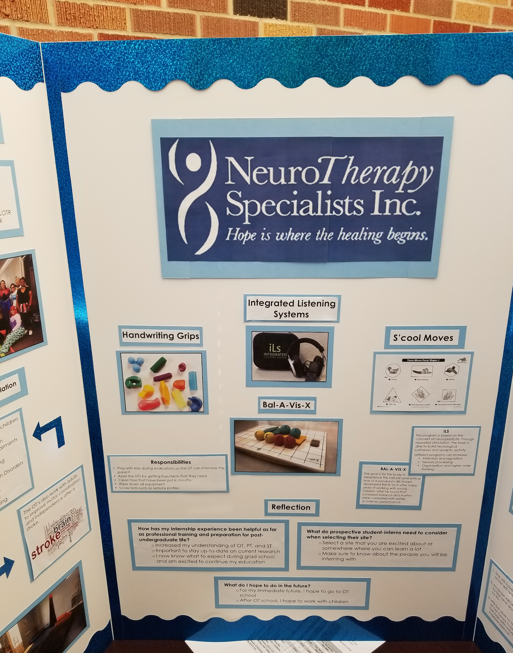
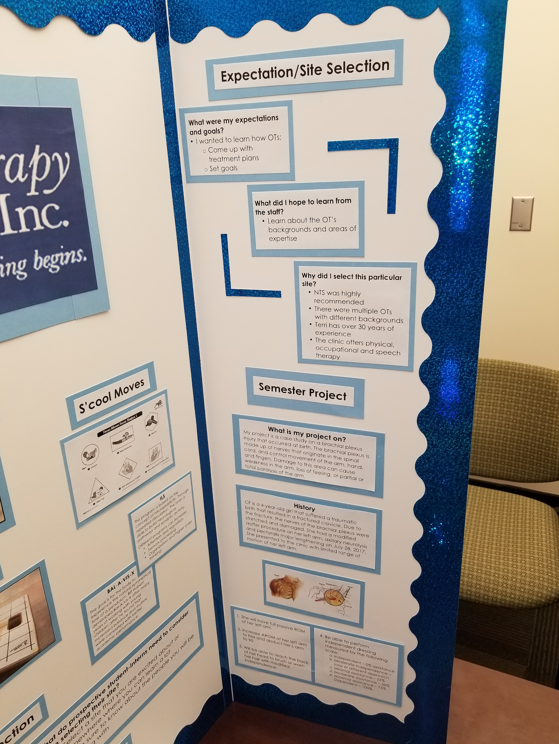

Slide 9
What reflection should include...
Discussion of personal interactions
Indication of problems
Explanation of course application
Indication of professional growth
Telling funny stories or interesting experiences

Slide 10
Evaluation of Reflection
Give constructive feedback
Use rubrics for grading

Slide 12
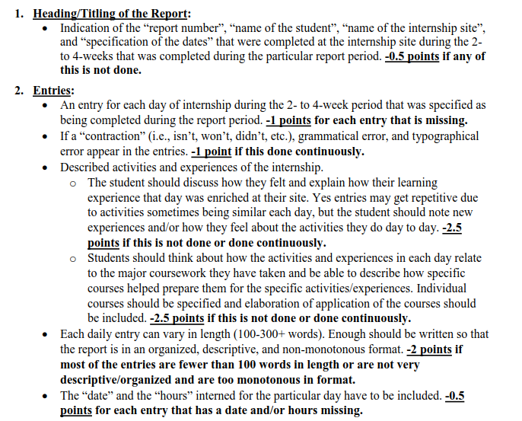
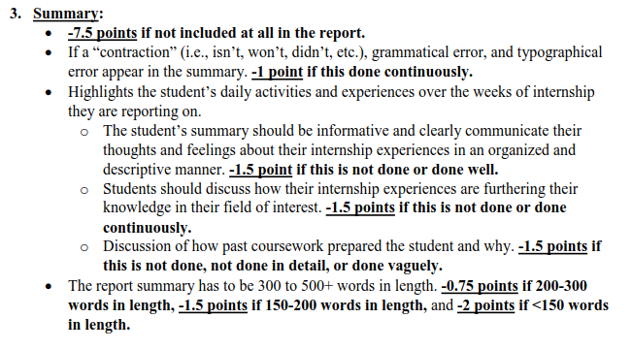

Slide 13
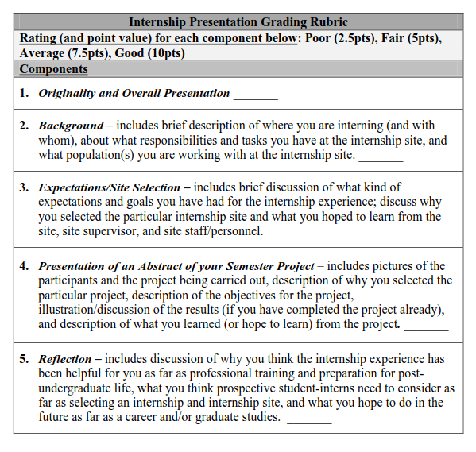

Slide 14
ACTIVITY
Write down one important skill you learned in college that you still use.
When you were a student, did you recognize its importance?

Slide 15
Students = Degree Seeking Missiles
Art Credits:
https://openclipart.org/detail/288920/rocket-missile
https://openclipart.org/detail/312236/graduation-cap-and-diploma-by-pinterastudio

Slide 16
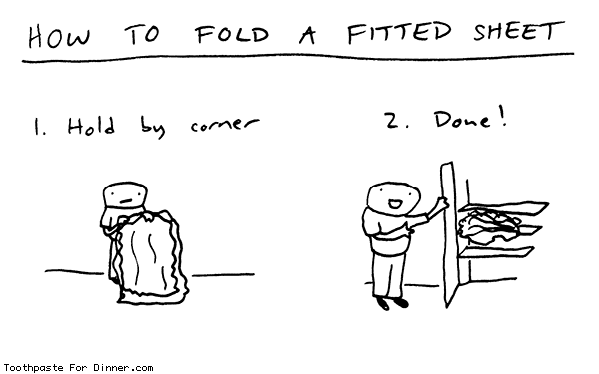
Reality = Fitted Sheet
“Being an adult is like folding a fitted sheet. No one really knows how.” -- Ursula Zalewski, Director, Experiential Education, Stony Brook University

Slide 17
Students have limited (or no) experience with:
Transferable skills Resume, Cover Letter, Interview On and off campus
Lifelong learning Imposter Syndrome “Job” vs. “Career”
Self-assessment Self-promotion

Slide 18
Why Reflection for Beyond College?
Broaden mindset to consider future as well as present
Highlight lifelong learning needed for growth, no “imposters”
Build self-assessment and self-promotion skills
Articulate in own language; translate to professional language

Slide 19
Incorporation Ideas
Introduce Concepts Example: Mention transferable/soft skills in assignment descriptions Revise Assignments/Documentation Example: At end of internship, ask students for skill-based resume Guided Reflection, written or oral Example: Ask students how will apply what learned to future Share with Students Example: Share own continuous learning

