Slide 1
Ensuring Quality in the Online Classroom with Experiential Objectives
Amber Narro Cherissa Vitter
Notes:
Cherissa Introduce

Slide 2
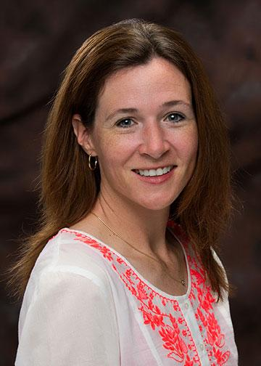
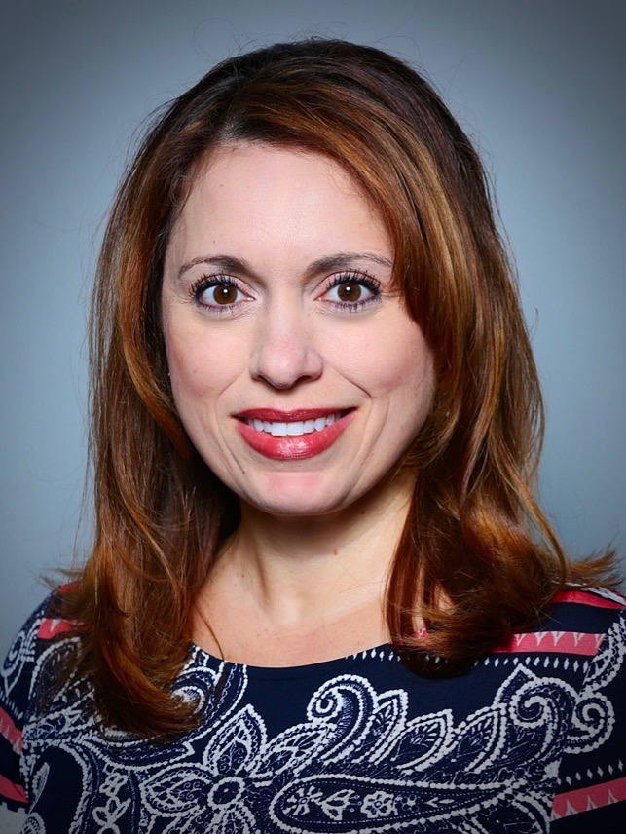
Introduction
International Baccalaureate Education
Coordinator: Office of Online Learning
Notes:
Cherissa - Amber

Slide 3
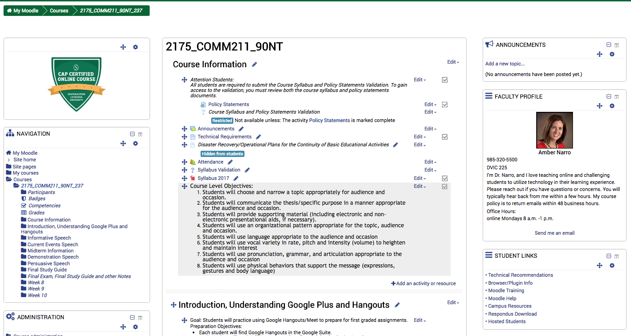
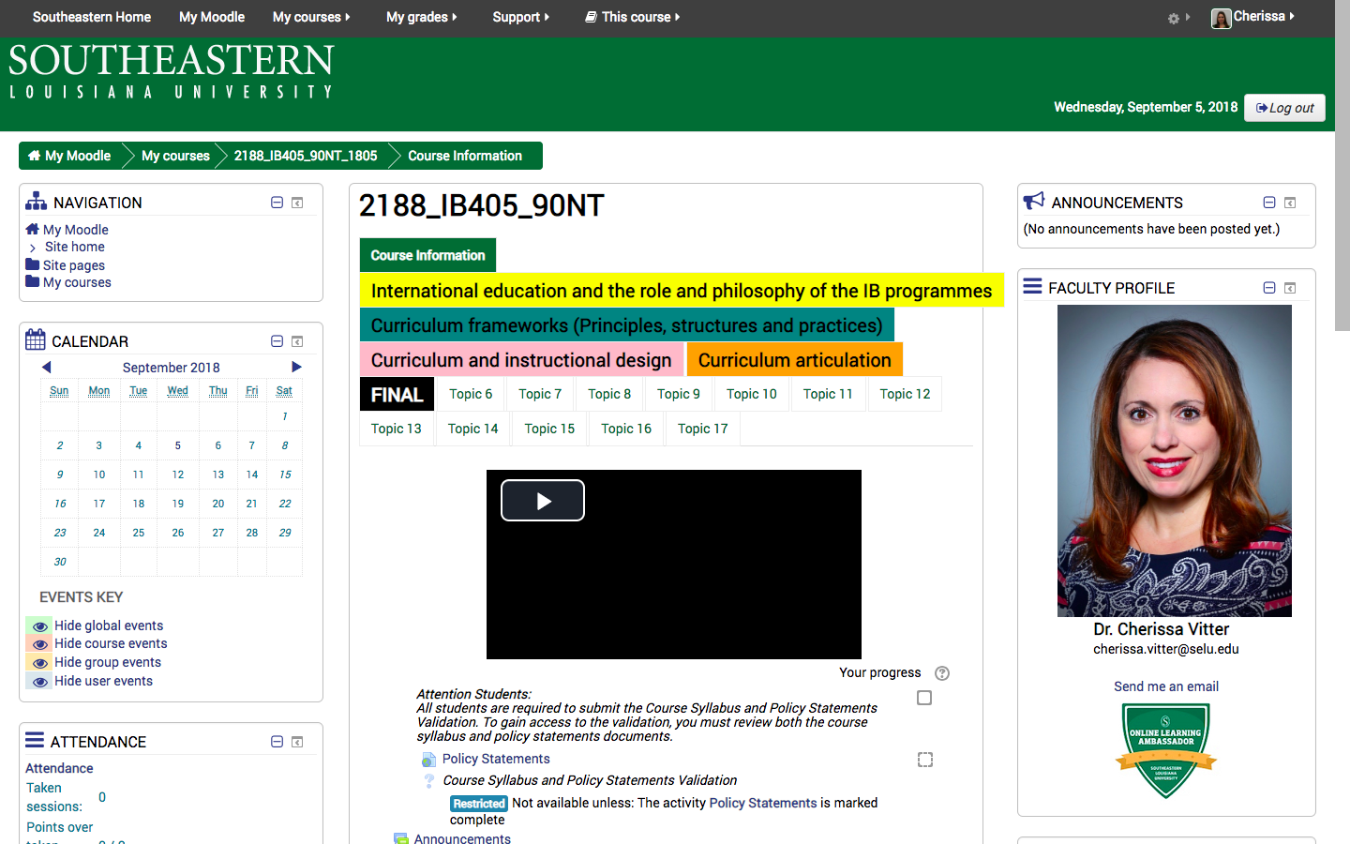
Course Examples
Comm 211
IB 405
Notes:
Amber

Slide 4
Objective
Student Understanding
Assessment
Evidence of Student Understanding

Slide 5
Assessment (Evidence)
Objective (Understand)
Skills (Definition)
Task (Verb)

Slide 6
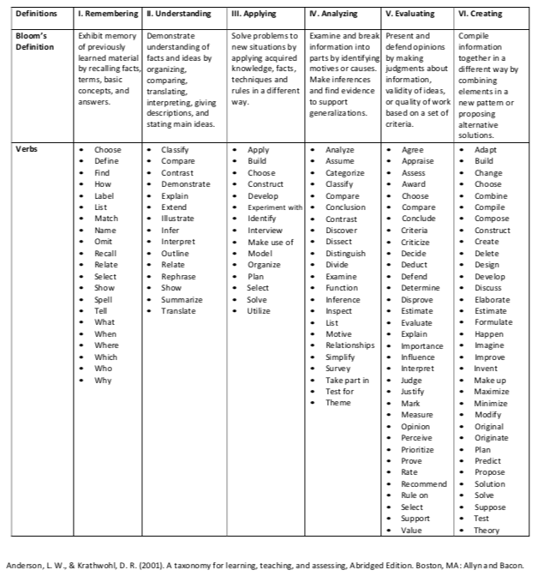

Slide 7
PUTTING IT
TOGETHER

Slide 8
FEARS
Testing
Integrity
Identity
Communication
Quality
Interactivity
Technology
Reaching course objectives
Notes:
11:30

Slide 9
Notes:
CAP

Slide 10
TIPS & TRICKS
Live Video
Video Presentations
Interactive Discussions
Applying through Creating
Setting the Standards Early
Use sustainable technology

Slide 11
...continue the conversation
Amber Narro Cherissa Vitter
amber.narro@selu.edu cherissa.vitter@selu.edu

