Slide 1
How To Certify Time

Slide 2
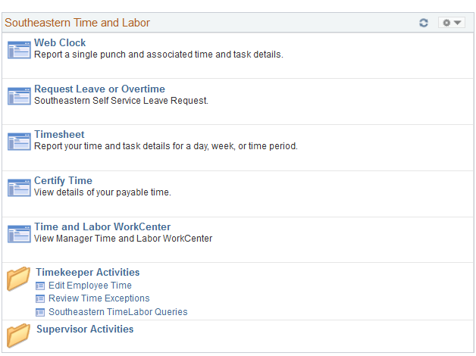
Time Approval Navigation
On navigation panel click – “Certify Time”

Slide 3
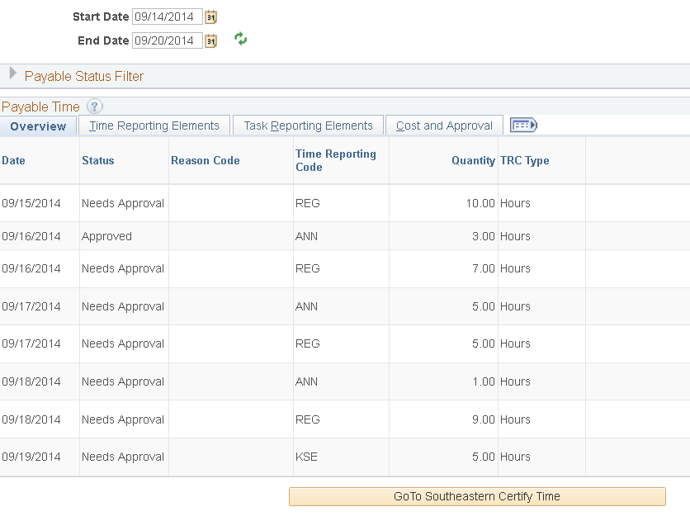
Employee - Approve time
The following screen will appear. Make sure the start date and end date for the period is correct, review your payable time and if your payable time is correct select “Go To Southeastern Certify Time.

Slide 4
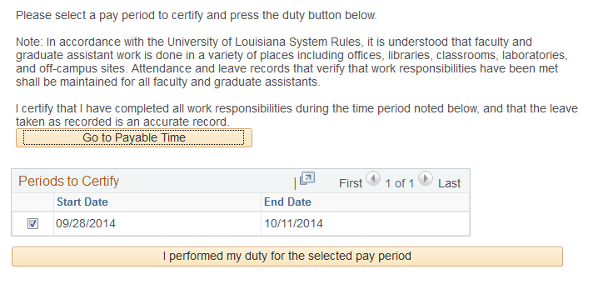
Certify Time
The following screen will appear. Select the pay period you would like to certify and click “I performed my duty for the selected pay period.”

Slide 5
For Questions or Support Call
Judy Bowles 549-5381
John Foster 549-3244
John Paul Domiano 549-3345

