Slide 1
Supervisor Training - Time and Labor 9.2

Slide 2
Improved Leave or Overtime Request Form

Slide 3
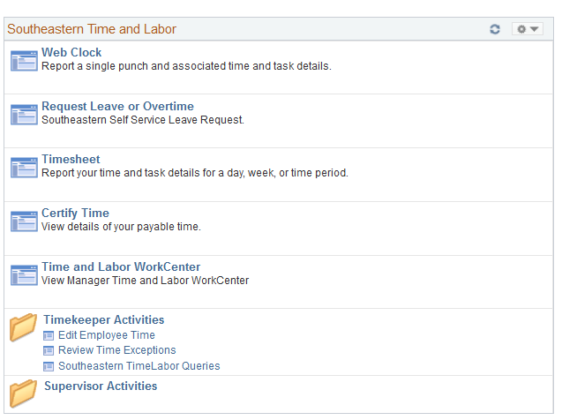
Leave or Overtime Request Form – Employee Side
On the Navigation Page go to “Request Leave or Overtime”

Slide 4
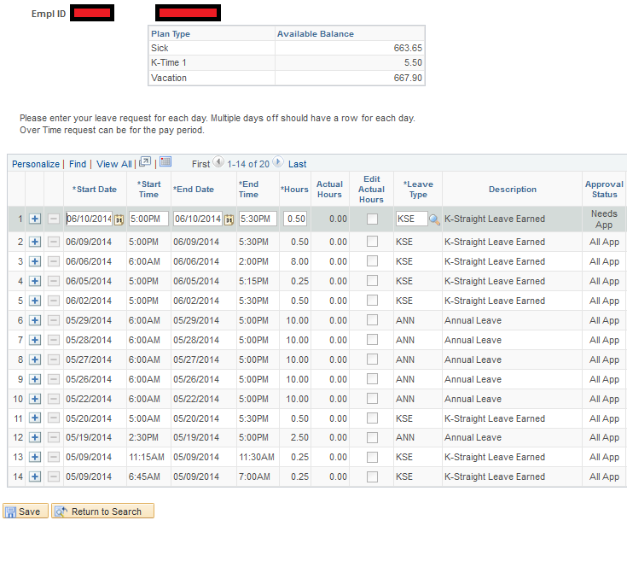
Leave and Overtime Request Form – Employee Side
Click the “+” button to request leave or overtime. Fill in the request and click “Save.

Slide 5
Leave and Overtime Request Form – Employee Side
Leave Request Form Improved Functionality
Employee can edit their leave request form after the leave has been approved and taken. For example, if an employee requests 5 hours of sick leave, but only takes three hours the employee can go into the leave request form and click the “Edit Actual Hours” button and put “3” in the “Actual Hours Box.” This change will automatically update the timesheet once the employee clicks save. If an employee edits their leave request the supervisor will receive an email.
Supervisors can still keep their current process for editing leave. Time and Labor 9.2 just allows the new functionality for employee input of actual leave hours taken.

Slide 6
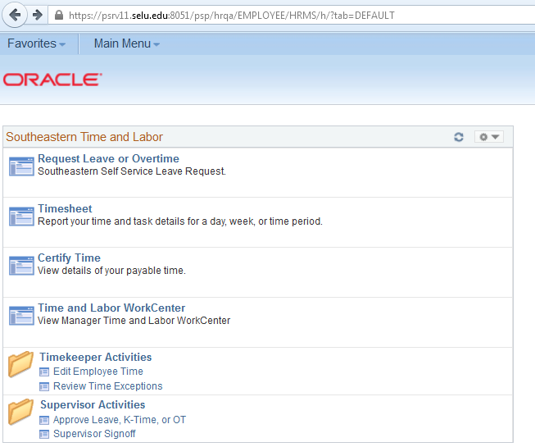
Approve Leave or Overtime Request – Supervisor View
Go to the navigation panel and click “Approve Leave, K-Time, or OT”

Slide 7
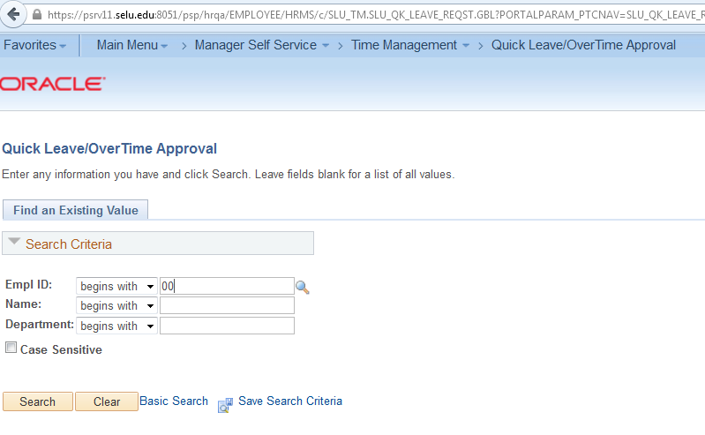
Approve Leave or Overtime Request – Supervisor View
The following screen will appear click “Search” to search all of your direct reports who have leave or overtime that needs to be approved, or complete the “Empl ID” field and hit search if you just want to see the leave or overtime requests for one employee.

Slide 8
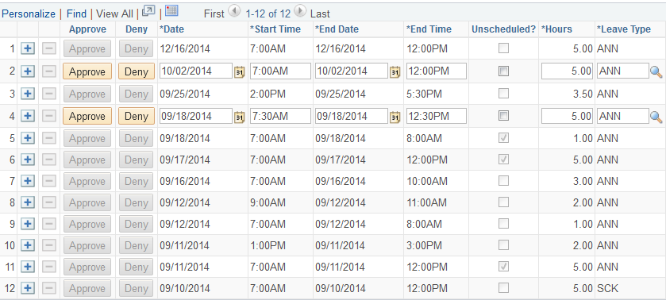
Approve Leave or Overtime Request – Supervisor View
Approve or deny the employee’s requests by clicking “Approve” or “Deny.” Requests that need attention will have the “Approve” or “Deny” highlighted in yellow.

Slide 9
Leave Balances
Note:
Leave balances requested and approved in current period for future pay periods effects current leave balances. As soon as the supervisor approves leave, the leave is posted to the timesheet and the leave is deducted from the leave balances.
If a scenario arises where approved leave in future pay periods needs to be deleted, the timekeeper will have to go into the appropriate future timesheet and delete the leave.

Slide 10
Timesheets

Slide 11
On the Navigation Panel go to “Timesheet”
To see your timesheet click “Timesheet” on the navigation panel.

Slide 12
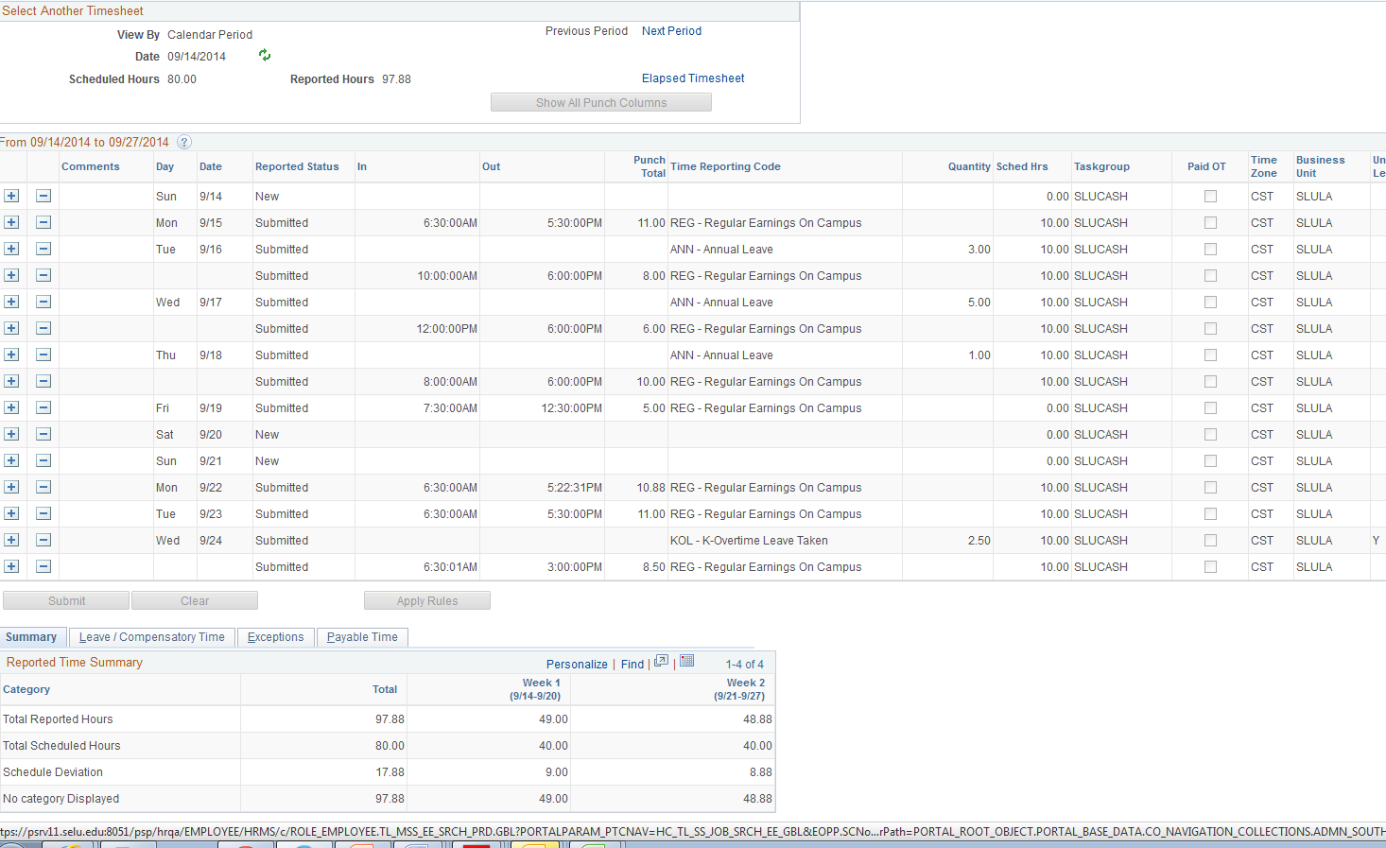
Employee’s Time Sheet
Your timesheet will appear. A new feature is that your payable time can be seen from the timesheet, just click “Payable Time”

Slide 13
Employee Time Certification

Slide 14
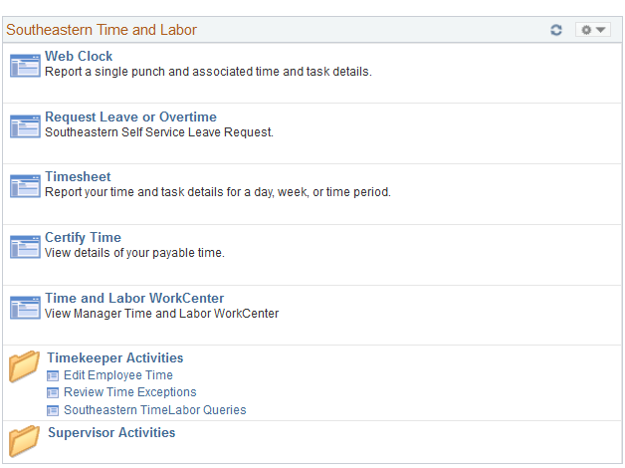
Time Approval Navigation
On navigation panel click – “Certify Time”

Slide 15
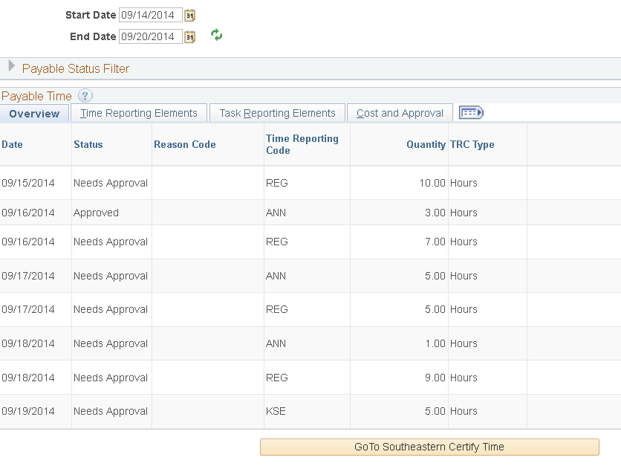
Employee - Approve time
The following screen will appear. Make sure the start date and end date for the period is correct, review your payable time and if your payable time is correct select “Go To Southeastern Certify Time.

Slide 16
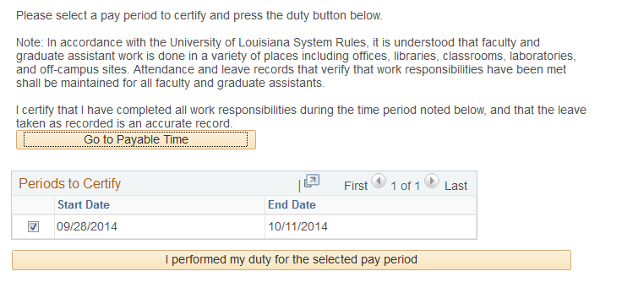
Certify Time
The following screen will appear. Select the pay period you would like to certify and click “I performed my duty for the selected pay period.”

Slide 17
Supervisors Signoff

Slide 18
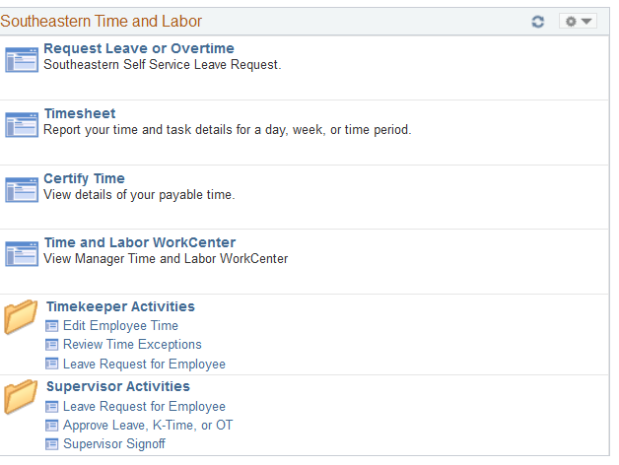
Supervisors - Navigation Page
On the navigation panel click “Supervisor Signoff

Slide 19
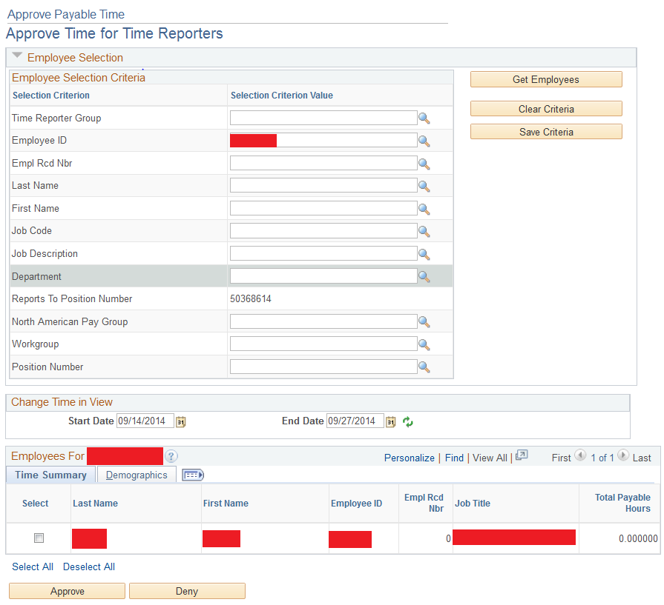
Your Employee’s Time
You can select one employee by completing the “Employee ID” field or you can select all of your direct reports by selecting “Get Employees” and leaving the “Employee ID” field blank. You can choose the select box next to an employee’s name and then click on the employee’s last name to see the employee’s payable time.

Slide 20
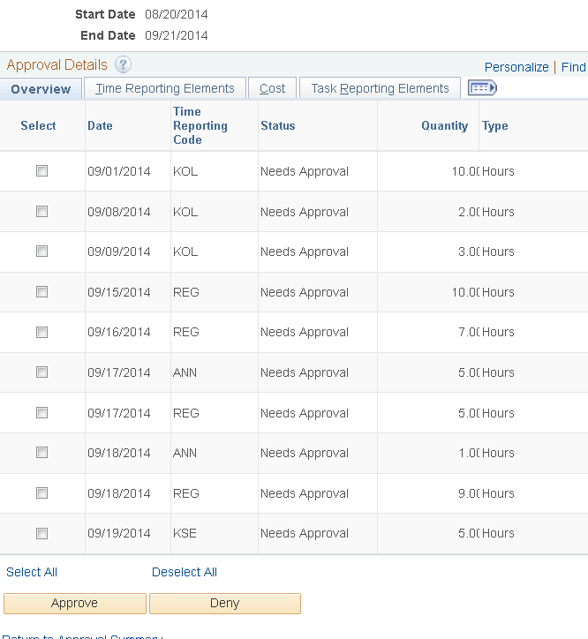
Approve Employee’s Time
You can review your employee’s payable time and then select “Approve” or “Deny.”

Slide 21
For Questions or Support Call
Judy Bowles 549-5381
John Foster 549-3244
John Paul Domiano 549-3345

